Slide 1
Privacy Preserving Data Visualization
IDC 6700 - Spring 2023
Sanjay Shanbhag

Slide 2
Contents
Privacy Concerns in the Data Visualization
Objective of the author
Methods to Anonymize
Creation of the Synthetic Dataset
Comparison of the author’s visuals vs my visuals

Slide 3
Privacy concerns in the Data Visualization
Informative graphs along with conventional statistical analysis give meaning to the numbers in the dataset. But it comes at the cost of privacy related risks.

Slide 4
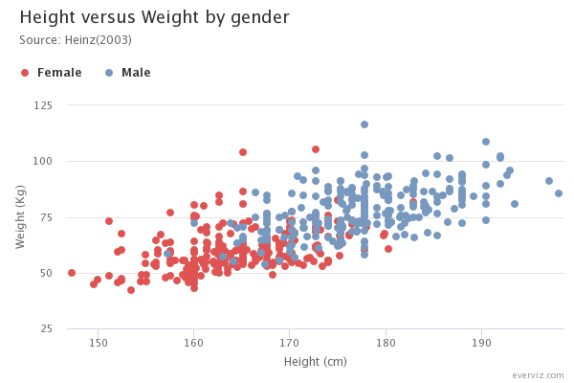
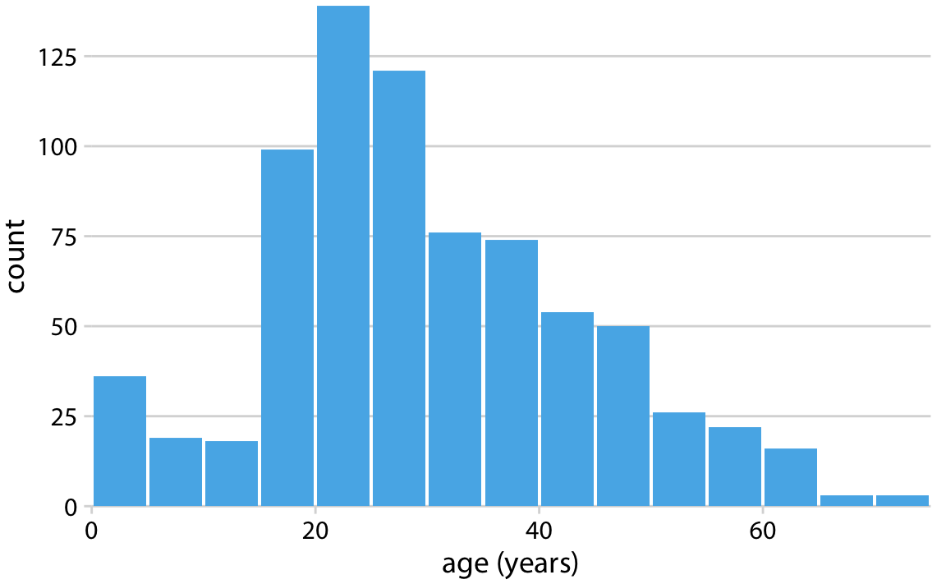
Potentially Disclosive visualizations
Source : Link
Source : Link

Slide 5
Objective of this paper
Present various anonymization techniques utilizing visualizations to preserve privacy in the sensitive Datasets
Ensuring intactness of the data even when privacy preserving techniques are being applied

Slide 6
Methods to Anonymize
K-Anonymization Technique
Probabilistic Approach
Deterministic Approach

Slide 7
Synthetic Data Generation
Mainly 3 sets of datasets were generated in this paper :
Dataset 1 → X ~ N(10,0.5)
Y ~ X + e where e ~ N(0,1)
Dataset 2 → X ~ LogN(0,0.5)
Y ~ Log(X) + e where e ~ U(0,1)
Dataset 3 → X ~ Beta( α = 5, β = 2)
Y ~ Beta( α = 0.5, β = 0.5 )

Slide 8
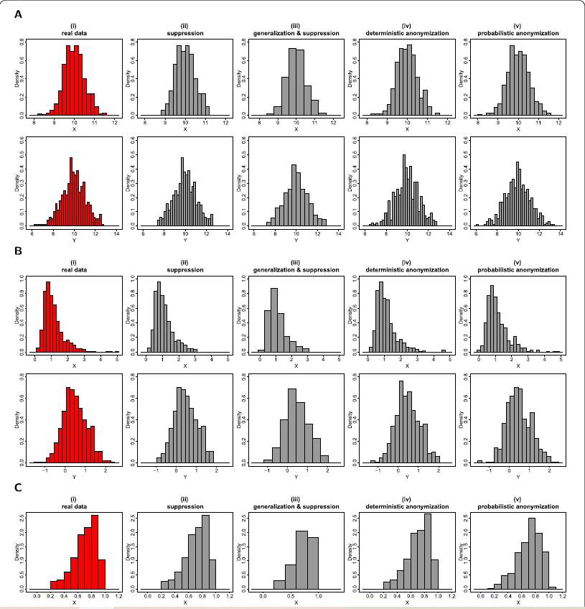
Visuals given in the journal for Histogram plot

Slide 9
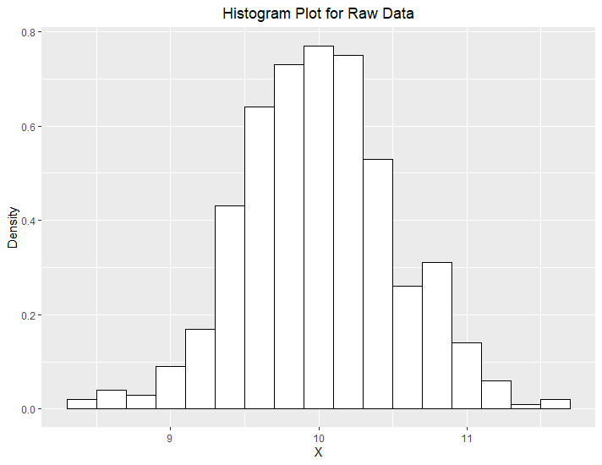
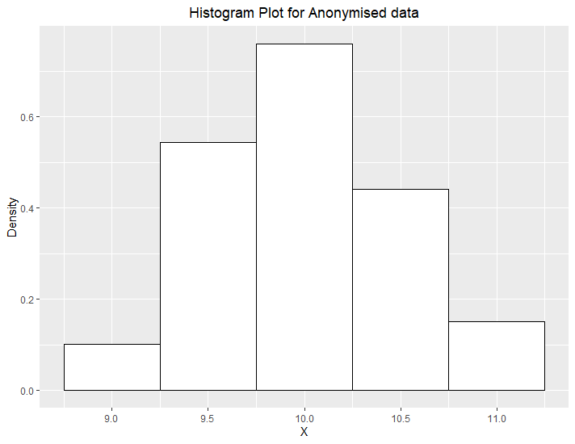
Application of K-anonymization method
Author’s Visuals

Slide 10
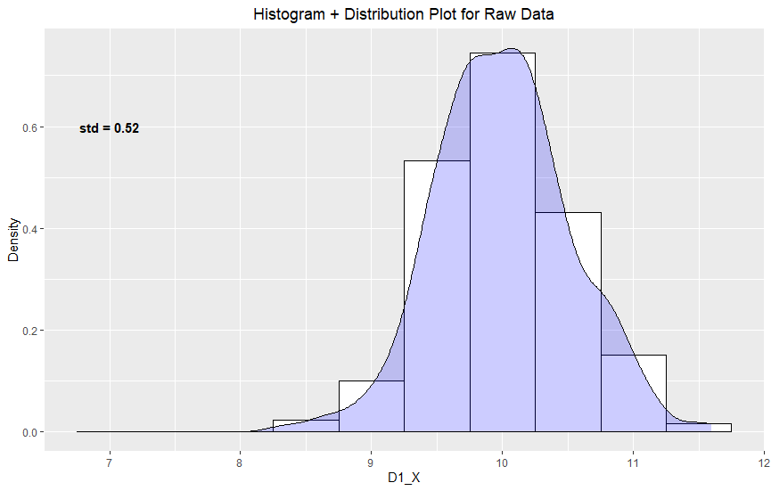
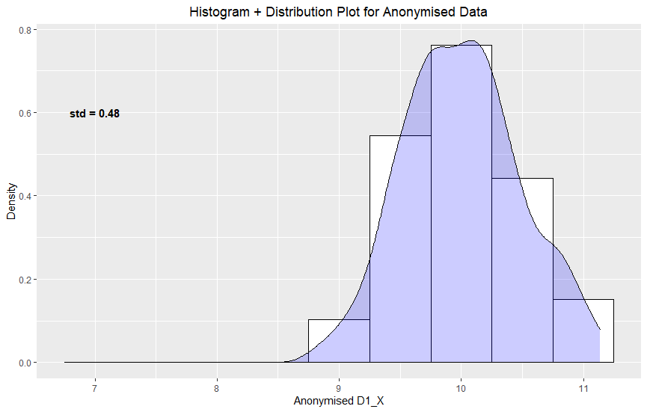
Application of K-anonymization method
My Approach

Slide 11
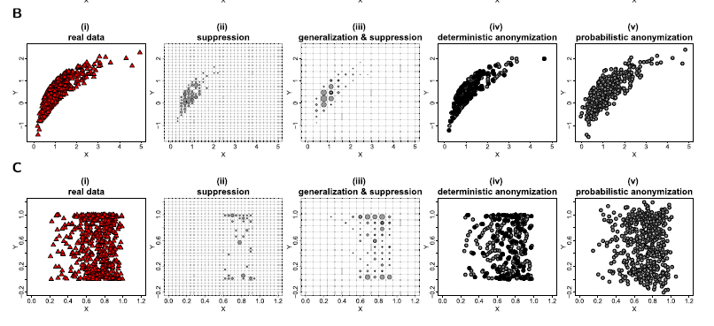
Visuals given in the journal for Scatter Plot

Slide 12
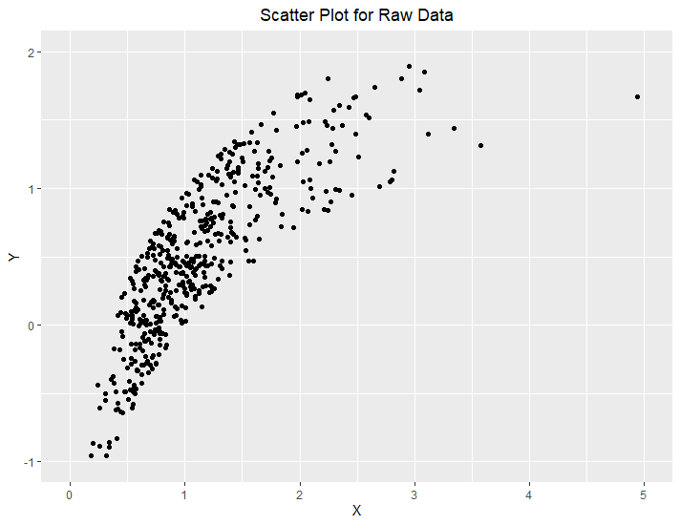
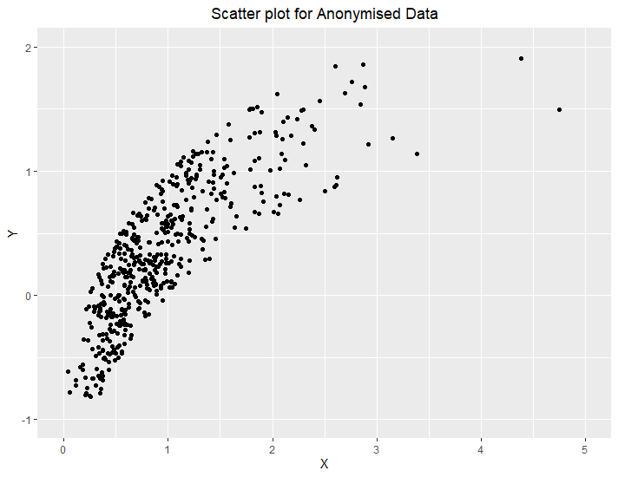
Application of Deterministic method
Author’s Visuals

Slide 13
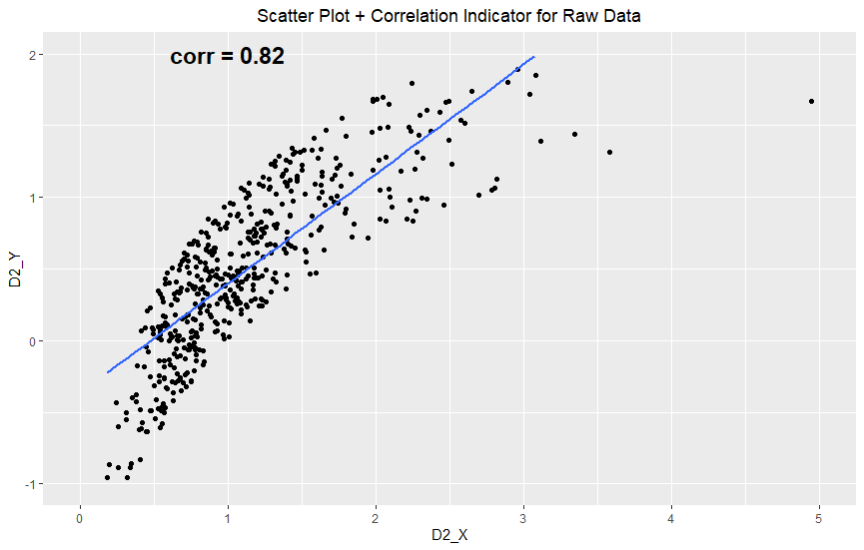
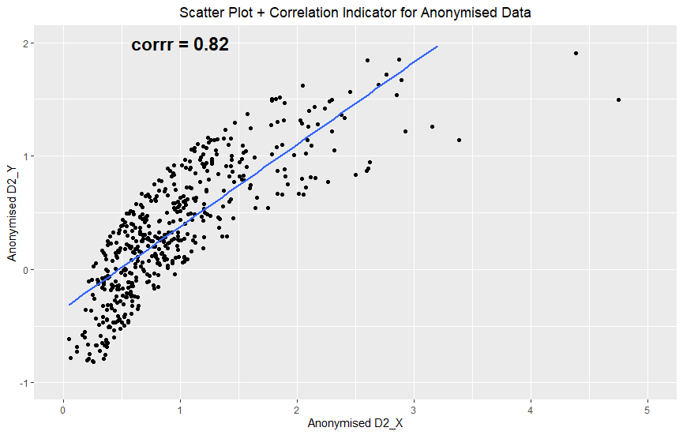
Application of Deterministic method
My Approach

Slide 14
References
Demetris Avraam, Rebecca Wilson, Oliver Butters, Thomas Burton, Christos Nicolaides, Elinor Jones, Andy Boyd & Paul Burton (2021) Privacy Preserving Data visualization https://epjdatascience.springeropen.com/articles/10.1140/epjds/s13688-020-00257-4

Slide 15
Thank you

